Slide 1
Digital Signature

Slide 2
Digital Signature is an authentication mechanism that enables the creator of a msg to attach a code that acts as a signature.
The signature is formed by taking the hash of the msg and encrypting the msg with creators private key.
Signature guarantees the source and integrity of the msg

Slide 3
Msg authentication protects two parties who exchange msg’s from third party, but it does not protect the two parties against each other
Eg : Mary can forge a msg and claim that it came from John. Mary would create a msg and append an authentication code using the key that Mary and John share
Where there is not complete trust between sender and receiver, something more than authentication is needed->Digital Signature

Slide 4
Properties
verify author, date & time of signature
authenticate the contents at the time of the signature
Be verifiable by third parties to resolve disputes

Slide 5
Requirements
Must be a bit pattern that depends on the msg being signed
Must use some information unique to the sender, to prevent both forgery and denial
Must be relatively easy to produce digital signature
Must be relatively easy to recognize and verify digital signature
Must be computationally infeasible to forge a digital signature
Must be practical to retain a copy of the digital signature in storage

Slide 6
Two approaches has been proposed for digital signature:
Direct Digital Signature
Arbitrated Digital Signature

Slide 7
Direct Digital Signature
Involves only the communication parties: Source and Destination
Destination knows the public key of the source
Formed by encrypting the entire msg with senders private key or by encrypting a hash code of the msg with senders private key
Confidentiality can be obtained by further encrypting the entire msg plus sig with either receivers public key or shared secret key
important that sign first then encrypt message & signature

Slide 8
Drawback: Security depends on the senders private key
If the sender wishes to deny sending a particular msg ,sender can claim the private key was stolen or lost or someone else forged her signature
To avoid this, require every signed msg to include a timestamp
Another threat, private key might actually stolen from X at time ‘T’
Opponent can then send a msg signed with X’s signature and time stamped with a time before or equal to ‘T’

Slide 9
Arbitrated Digital Signature
Every signed msg from a sender X to a receiver Y goes first to an arbiter A, who subjects the msg and its signature to a number of tests to check its origin and contents
Msg is then dated and sent to Y with an indication that it has been verified to the satisfaction of the arbiter

Slide 10
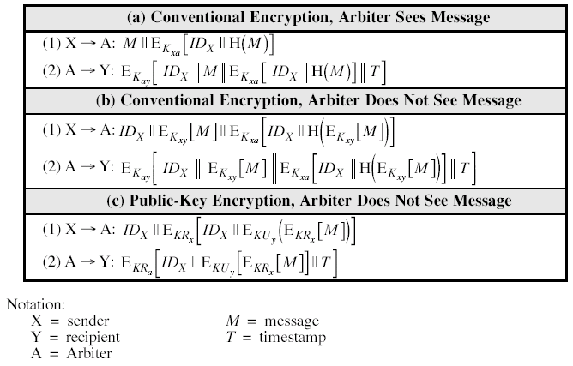

Slide 11
a)
Sender X and arbiter A share a secret key K_{xa}
A and Y share secret key K_{ay}
X constructs a msg M and computes its hash value H(M)
X transmits msg plus a signature to A
Signature consists of identifier of X,IDx plus hash value,all encrypted using K_{xa}
A decrypts the signature and checks the hash value to validate the msg
A transmits the msg to Y encrypted with K_{ay}

Slide 12
Msg includes IDx, the original msg from X, the signature and a timestamp
Y can decrypt this to recover the msg and signature
Timestamp informs Y that this msg is timely and not replay
In case of dispute Y, who received msg M from X sends following msg to A:
E(K_{ay}[IDx||M||E(K_{xa}[IDx||H(M)])])
Arbiter uses K_{ay} to recover IDx, M and signature, then uses Kxa to decrypt the signature and verify hash code

Slide 13
Both sides have high degree of trust in A
X must trust A not to reveal K_{xa} and not to generate false signature of the form E(K_{xa}[IDx||H(M)])
Y trust A to send E(Kay[IDx||M||E(Kxa[Idx||H(M)]||T])only if the hash value is correct and the signature was generated by X
Both sides must trust A to resolve dispute fairly
A is able to read msg from X to Y

Slide 15
b)
Provides confidentiality
X and Y share the secret key Kxy
X transmits an identifier , a copy of msg encrypted with Kxy and signature to A
Signature consists of the identifier plus the hash value of the encrypted msg,all encrypted using Kxa
A decrypts the signature and checks the hash value to validate the message
A is working only with encrypted version of the msg and is prevented from reading it
A then transmits everything that it received from X,plus a timestamp,all encrypted with Kay to Y

Slide 17
C)
X double encrypts a msg M first with X’s private key KRx and then with Y’s public key KUy
This signed msg,together with X’s identifier is encrypted again with KRx and together with IDx is sent to A
Double encrypted msg is secure from arbiter
A can decrypt the outer encryption to assure that the msg must have come from X
Then A transmits a msg to Y, encrypted with KRa
The msg includes IDx, double encrypted msg and a timestamp

Slide 18
Advantages:
1.No information is shared among parties before communication, preventing alliances to defraud
2.No incorrectly dated msg can be sent
3.Content of the msg from X to Y is secret from A and anyone else
Drawback: involves encryption of the msg twice with public key algm

Slide 19
Authentication Protocol
Used to convince parties of each others identity and to exchange session keys
May be one-way or mutual

Slide 20
Mutual Authentication:
Enable communicating parties to satisfy themselves mutually about each other’s identity and to exchange session keys
key issues are
confidentiality – to protect session keys
timeliness – to prevent replay attacks

Slide 21
Replay Attacks
Simple Replay: Opponent copies a msg and replays it later
Repetition that can be logged: Opponent replay a time stamped msg within the valid time windows
Repetition that cannot be detected: Original msg is suppressed and did not arrive its destination; only the replay msg arrives
Backward replay without modification:Replay back to the msg sender;
In symmetric encryption sender cannot differentiate msg sent and msg received based on the content

Slide 22
Solution:Attach a sequence no: to each msg
Difficulty:Require each party to keep track of the last sequence no.
So sequence no is not used
Following two approaches are used:
Timestamp: Party A accepts a msg as fresh only if the msg contains a timestamp that, in A’s judgment ,is close enough to A’s knowledge of current time. Clocks should be synchronized
Challenge/Response : Party A, expecting a fresh msg from B,first sends B a nonce(challenge) and requires that the subsequent msg(response) received from B contain the correct nonce value

Slide 23
Timestamp approach not used-connection oriented because:
1.Protocol is needed to maintain synchronization among processor clock
2.Successful attack will happen if there is temporary loss of synchronization
3.Distributed clock cannot be expected to maintain precise synchronization

Slide 24
Challenge-Response is unsuitable for connectionless
Requires the overhead of a handshake before any connectionless transmission

Slide 25
Symmetric Encryption Approaches
Trusted key distribution center
Each party shares master key with KDC
KDC is responsible for generating keys to be used for a short time over a connection between the two parties

Slide 26
Needham & Schroeder protocol:
For secret key distribution using a KDC
original third-party key distribution protocol
for session between A B mediated by KDC
protocol overview is:
1. A->KDC: ID_{A} || ID_{B} || N₁
2. KDC -> A: E(K_{a},[K_{s}||ID_{B}||N₁|| E(K_{b},[K_{s}||ID_{A}])])
3. A -> B: E(K_{b}, [K_{s}||ID_{A}])
4. B -> A: E(K_{s}, [N₂])
5. A -> B: E(K_{s}, [f(N₂)])

Slide 27
Each user shares a unique master key with KDC
A wishes to establish logical connection with B and requires session key
A has a master key Ka shared between A and KDC
Similarly B,Kb
Steps
A issues a request to KDC for session key . Msg includes identity of A and B and a unique identifier N1 for this transaction
KDC responds->msg encrypted with Ka,only A can read it.Msg also includes
One time session key Ks
Original request msg,to match this response with appropriate request

Slide 28
Msg also includes 2 items for B:
One time session key Ks
Identifier of A,Ida
These two items encrypted with kb
They are to be sent to B to establish the connection and prove A’s identity
A stores session key and forward to B the information that originated at the KDC for B
Session key has been securely delivered to A and B,and they begin their protected exchange.
B sends a nonce ,N2 to A
Using Ks,A responds with f(N2),f is a fun that performs transformation on N2

Slide 29
Still vulnerable to replay attack
Modification to Needham & Schroeder protocol(Denning Protocol), includes timestamp to step 2 and 3
1.A->KDC: ID_{A} || ID_{B}
2. KDC -> A: E(K_{a},[K_{s}||ID_{B}||T|| E(K_{b},[K_{s}||ID_{A}||T])])
3. A -> B: E(K_{b}, [K_{s}||ID_{A}||T])
4. B -> A: E(K_{s}, [N₁])
5. A -> B: E(K_{s}, [f(N₁)])
Increased security compared to previous
Drawback-Requires reliance on clocks that are synchronized throughout the network

Slide 30
Problem occurs when a senders clock is ahead of the intended recipients clock
Opponent can intercept a msg from the sender and replay it later when the timestamp in the msg become current at the recipients site , results in unexpected results->suppress replay attack
Solution:Parties regularly check their clock against the KDC’s clock
or,Rely on handshaking protocols using nonce

Slide 31
To overcome all, new protocol:
A->B ID_{A}||Na
B->KDC ID_{B}||Nb||E(Kb[ID_{A}||Na||Tb])
KDC->A
E(Ka[ID_{B} ||Na||Ks||Tb])||E(Kb[ID_{A}||Ks||Tb])||Nb
A->B E(Kb[IDA||Ks||Tb])||E(Ks , Nb)
1.A initiate by generating a nonce Na and sending that plus its identifier to B. Nonce will be returned to A in an encrypted msg that includes session key, assuring A of its timeliness
2.B alerts KDC that a session key is needed . Msg to KDC includes its identifier and a nonce, Nb. Nonce will be returned to B in an encrypted msg that includes the session key, assuring Bof its timeliness

Slide 32
3.KDC passes on to A B’s nonce and block encrypted with the secret key that B shares with the KDC.
Block serves as a “ticket” that can be used by A for subsequent authentications
KDC also sends to A a block encrypted with secret key shared by A and KDC. Block verifies B has received A’s initial msg’s(IDB).It provides A with session key (Ks)and time limit on its use
4.A transmits the ticket to B,together with B’s nonce,the latter encrypted with the session key.
Ticket provides B with secret key that is used to decrypt E(Ks,Nb)to recover the nonce

Slide 33
Public –Key Encryption Approaches
A->AS ID_{A}||ID_{B}
AS->A E(PRas[ID_{A}||Pua||T])||E(PRas[ID_{B}||Pu_{b}||T])
A->B E(Pras[ID_{A}||Pua||T])||E(PRas[ID_{B}||Pu_{b}||T])
||E(Pub,E(Pra[Ks||T])
Central system-Authentication server provides public key certificates
Session key is chosen and encrypted by A
Drawback: Requires Synchronization of clocks

Slide 34
Another approach by Woo and Lam
1.A→KDC: ID_{A} || ID_{B}
2. KDC→A: E(PR_{auth}[ID_{B} || PU_{b}] )
3. A→B: E(_{PUb}[N_{a} || ID_{A}])
4. B→KDC: ID_{B} || ID_{A} || E(PU_{auth}[N_{a}])
5. KDC→B: E_{(PRauth}[ID_{A}||PU_{a}] || E_{PUb}[E_{PRauth} [N_{a} ||K_{s}|| ID_{B}]]
6. B→A: E_{PUa}[E_{PRauth} [N_{a} ||K_{s}|| ID_{B}] || N_{b}]
7. A→B: E_{ks}[N_{b}]
1.A informs KDC of its intention to establish a connection with B
2.KDC returns to A a copy of B’s public key certificate
3.Using B’s public key,A informs B of its desire to communicate and sens a nonce Na

Slide 35
4.B asks KDC for A’s public key certificate and request a session key.B includes A’s nonce that the KDC can stamp the session key with that nonce. Nonce is protected using KDC’s public key
5.KDC returns to B a copy of A’s public key certificate plus{Na,Ks,ID_{B}}
6.Above triple encrypted with KDC’s private key is relayed to A,together with a nonce Nb generated by B
7.Assures B of A’s knowledge of session key

Slide 36
One-way Authentication
Recipient wants some assurance that the msg is from the alleged sender
Symmetric Encryption Approach
1. A->KDC: ID_{A} || ID_{B} || N₁
2. KDC -> A: E(K_{a}, [K_{s}||ID_{B}||N₁ || E(K_{b},[K_{s}||ID_{A}])])
3. A -> B: E(K_{b}, [K_{s}||ID_{A}]) || E(K_{s}, M)
does not protect from replay attack
Guarantees that only the intended recipient of a msg will be able to read it

Slide 37
Public key encryption Approaches:
Confidentiality prime concern
A->B:E(Pub,Ks)||E(Ks,M)
Msg is encrypted with a one-time secret key
Encrypting one-time key with B’s public key.Only B can decrypt it
Authentication prime concern
A->B:M||E(Pra,H(M)
To be more secure both msg and signature are encrypted with recipients public key
A->B:E(Pub,[M||E(Pra,H(M))])
To make it more timely
A->B:M||E(Pra,H(m))||E(Pras[T||IDA||Pua])

Slide 38
Digital Signature Standard
uses the SHA hash algorithm
DSS is the standard, DSA is the algorithm

Slide 39
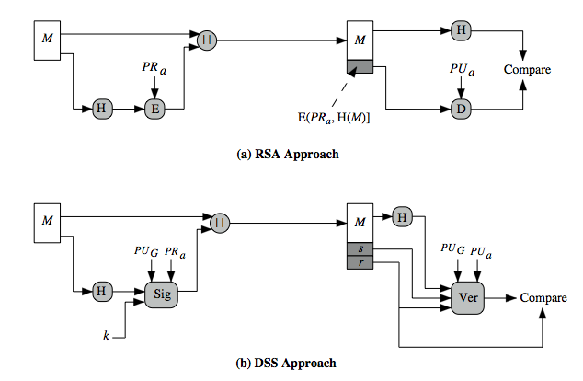

Slide 40
DSS use a hash function
Hash code is provided as i/p to a signature fun along with a random number k
Signature fun also depends on the senders private key(PRa) and a global public key PUg
Resulting sig consists of 2 parts : and r
At the receiving end, hash code of the incoming msg is generated
This plus the sig is put input to a verification fun
Verification fun also depends on global public key and senders public key
Output of the verification fun is a value that is equal to the sig component r,if sig is valid

Slide 41
Digital Signature Algorithm (DSA)
creates a 320 bit signature
with 512-1024 bit security
smaller and faster than RSA
a digital signature scheme only
security depends on difficulty of computing discrete logarithms

Slide 42
DSA Key Generation
have shared global public key values (p,q,g):
choose 160-bit prime number q
choose a large prime p with 2^{L-1} < p < 2^{L}
where L= 512 to 1024 bits and is a multiple of 64
such that q is a 160 bit prime divisor of (p-1)
choose g = h^{(p-1)/q}
where 1<h<p-1 and h^{(p-1)/q} mod p > 1
users choose private & compute public key:
choose random private key: x<q
compute public key: y = g^{x} mod p

Slide 43
DSA Signature Creation
to sign a message M the sender:
generates a random signature key k, k<q
nb. k must be random, be destroyed after use, and never be reused
then computes signature pair:
r = (g^{k} mod p)mod q
s = [k⁻¹(H(M)+ xr)] mod q
sends signature (r,s) with message M

Slide 44
DSA Signature Verification
having received M & signature (r,s)
to verify a signature, recipient computes:
w = s⁻¹ mod q
u1= [H(M)w ]mod q
u2= (rw)mod q
v = [(g^{u1} y^{u2})mod p ]mod q
if v=r then signature is verified

Slide 45
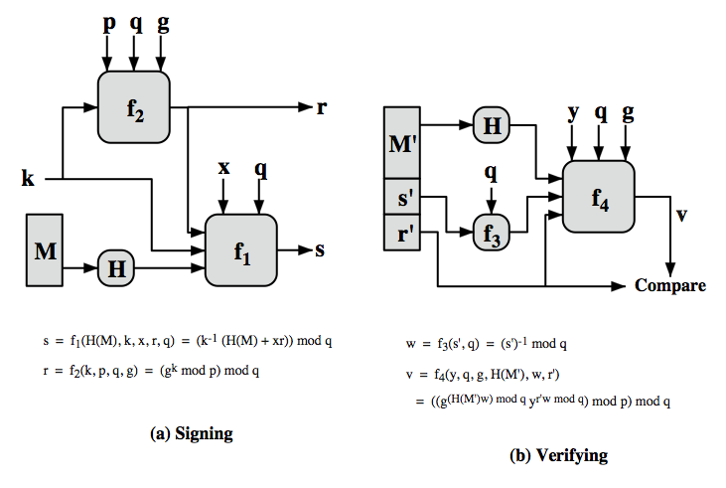
having received M & signature (r,s)
to verify a signature, recipient computes:
w = s⁻¹ mod q
u1= [H(M)w ]mod q
u2= (rw)mod q
v = [(g^{u1} y^{u2})mod p ]mod q
if v=r then signature is verified

